Slide 1
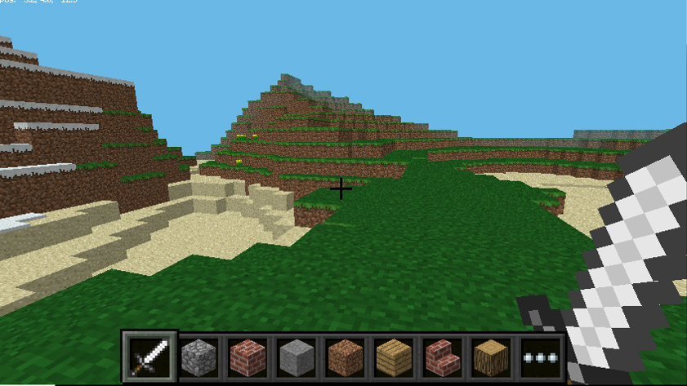
Introduction to Minecraft Pi
Objective:
To learn what Minecraft is
To learn how to enter code into Minecraft Pi
To successfully enter Python programs into Minecraft Pi

Slide 2
What is Minecraft Pi?
Minecraft is a program which lets you build virtual worlds, block-by-block, in a range of different materials.
You get a basic world given to you, it is then up to you what goes into it.
Minecraft Pi is an early development version of Minecraft Pocket Edition for phones & tablets.

Slide 3
Minecraft is deliberately ‘blocky’ like LEGO, because it is easy to build when your bricks are the same shape!
The blocks are deliberately NOT highly detailed as this means the graphics can be drawn/updated quickly as you move around.
The Pi edition is special because it is not ‘locked down’ so you can code straight into it and make ‘Magic happen.’

Slide 4
Get Set…
You will need to arrange 2 program windows on your desktop
Minecraft Pi
Python / IDLE
Python is the programming language you will use to interact with Minecraft (make buildings, show messages, etc.)
Load BOTH programs and arrange your screen like this…

Slide 5
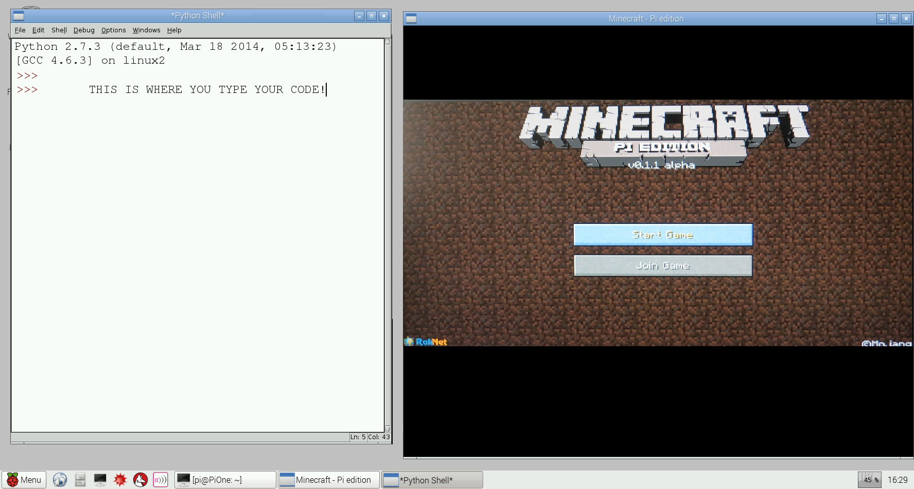
Minecraft & IDLE/Python Screens
To enter your code, you click FILE and NEW…
To move the mouse out of Minecraft, press the TAB key first

Slide 6
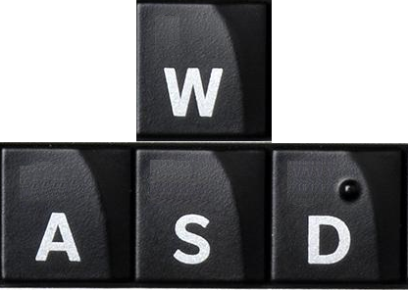

Moving around in Minecraft
Have a quick look around your world, before we move on
SPIN CAMERA
UP
LEFT
RIGHT
DOWN
Key | Action
Space | Jump
Double-Tap Space | Fly or Land
Shift | Duck
E | Inventory
Esc | Back to Menu
PLACE BLOCK
DESTROY BLOCK

Slide 7
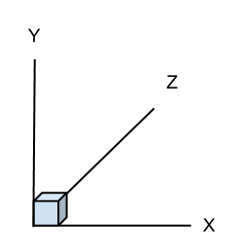
Where am I?
Graphs use X co-ordinates for left-right and Y co-ordinates for up-down.
Minecraft is a 3D game, so also has forwards-backwards movement.
X = Left-Right Y = Up-Down Z = Forward-Backward

Slide 8
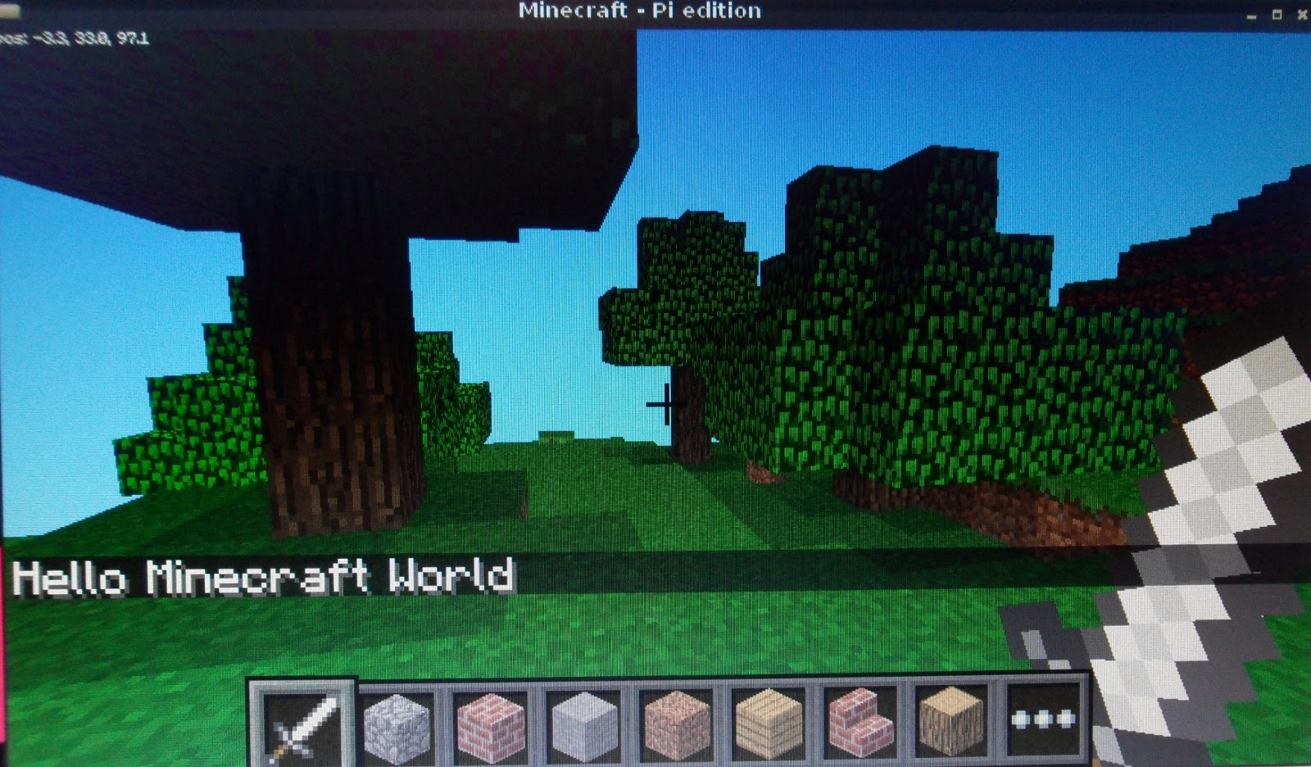
There I am!
( -3, 33, 97 )

Slide 9
Text Messages
Start a new Python window, by clicking ‘File’ and ‘New.’
Click in your new empty Python window and type this code.
import mcpi.minecraft as minecraft
mc = minecraft.Minecraft.create()
msg = “Hello world”
mc.postToChat(msg)
Click on File and save your code in your Pi ‘Documents’ folder as text.py
Try another few. What happens with long sentences?
Capital letters and spaces MUST be correct, or your code won’t work

Slide 10
Sources
http://fortoffee.org.uk/wp-content/uploads/2014/07/Worksheet-Minecraft.pdf
http://blog.whaleygeek.co.uk/minecraft-pi-with-python/
http://www.stuffaboutcode.com/p/minecraft.html
Adventures In Raspberry Pi – Carrie Anne Philbin – John Wiley & Sons – 2014
https://www.stem.org.uk/resources/community/resource/5578/raspberry-pi-minecraft-pi-unit

Slide 11
The End

